Slide 1

Analyse Image Classification (Use Encoder Output Images)
Information Technology Course
Module Software Engineering
by Damir Dobric / Andreas Pech
Team Name: Team Acroaticus
Team Members:
Samsil Arefin
Niloy Sarker

Slide 2
Contents
Introduction
HTM
SDR
DateTime Encoder
Dataset
Training Phase
APPROACH
Experiments and Results
Conclusion

Slide 3
Introduction
Objectives: The main goal is to create encoder output image datasets and by using these datasets, a series of experiment to determine the optimal parameter combination for achieving good and accurate similarity between encoder output images.

Slide 4
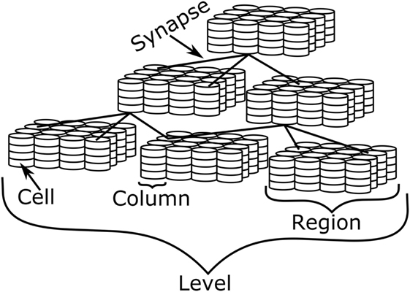
HTM
Hierarchical temporary memory emerged from neocortex neuroscience and is currently one of the most extensively utilized applications for images identification and fault detection.

Slide 5
SDR
SDRs correspond to neocortical active neurons. An SDR is a massive array of bits, the vast majority of which are turned off (0s) and only a few are turned on (1s) (1s). The SDR is literally an array of 0’s and 1’s, and because the HTM concept is attempting to build a system based on the same principles of brain function, the SDRs are a mathematical representation of these sparse signals, which will likely contain around 2

Slide 6
DateTime Encoder
Range (R)
Width (W)
Radius (r)
Maximum and Minimum Values
Output bit count (n)

Slide 7
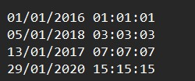

Dataset
Here, we use different dates & times as a dataset (as of 01/01/2021 15:13:03) to generate bitmap images. Then we use these bitmap images like the below as input images to find the similarity between bitmap images.
Date & Time input Bitmap Image

Slide 8
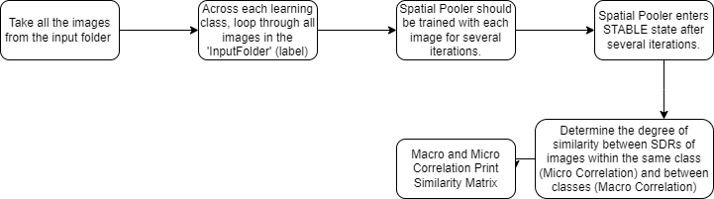
Training Phase
There are some steps that the software takes to determine the similarity of the images in order to produce an output. This is the Training Image Working Process.

Slide 9
APPROACH
By changing various HTM Parameters to find the best fit correlation Matrix.
Change the learning parameters to find the best fit that demonstrates image classification.
Global/Local Inhibition, Potential Radius, Local Area Density, and NumofActiveColumnsPerInArea are the most important learning parameters, and we discovered how these parameters influenced learning.

Slide 10
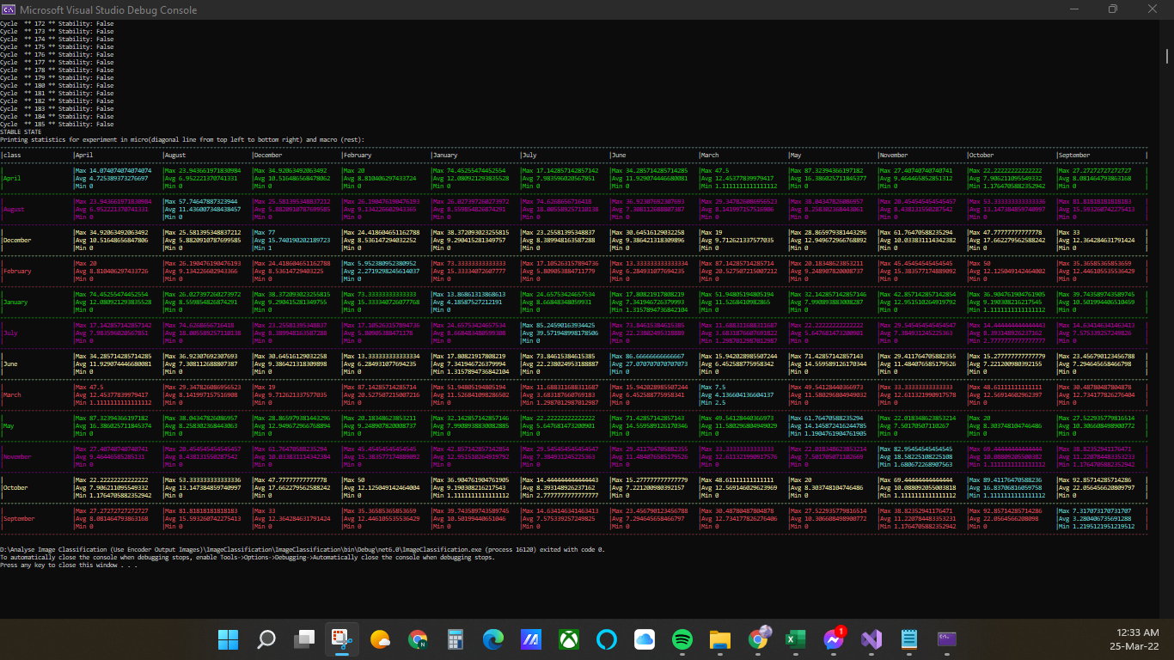
Experiments and Results

Slide 11
Conclusion
1. In this day, many smart machines use image recognition to identify themselves. It can be used in a variety of realworld scenarios such as the medical field, robot vision, video processing, and so on.
2. Advances in our understanding of how our brains work biologically may lead to new and revolutionary approaches to achieving true machine intelligence, which is the goal of the HTM theory.
3. The test demonstrates how the HTM parameters influence learning and determines the best-fit correlation matrix.

Slide 12
References
[1] J. Mnatzaganian, E. Fokoue´ and D. Kudithipudi, ”frontiers in Robotics and AI,” [Online]. Available: https://www.frontiersin.org/articles/10.3389/frobt.2016.00081/full.
[2] E. N.-A. I. Panov, ”Hierarchical Temporal Memory with Reinforcement Learning,” Hierarchical Temporal Memory with Reinforcement Learn-ing, 2020.
[3] J. Hawkins, ”Hierarchical Temporal Memory (HTM) Whitepaper,” Hi-erarchical Temporal Memory (HTM) Whitepaper, 2011.
[4] R. S.-T. L.-A. A.-J. Machado, ”Hierarchical Temporal Memory Theory Approach to Stock Market Time Series Forecasting,” Advances in Public Transport Platform for the Development of Sustainability Cities, 2021.
[5] Purdy, S. (1970, January 1). [PDF] encoding data for HTM sys-tems: Semantic scholar. undefined. Retrieved March 30, 2022, from https://www.semanticscholar.org/paper/Encoding-Data-for-HTM-
Systems-Purdy/14552052a0ee729539298e4f8eb42292c0eb1622?p2df
[6] Numenta, ”Encoders - NuPIC 1.0.3 documentation,” Sphinx 1.5.3 , 2017.
[7] Ddobric. “DDOBRIC/Neocortexapi: C.Net Core Implementation of Hi-erarchical Temporal Memory Cortical Learning Algorithm.” GitHub, https://github.com/ddobric/neocortexapi.

